Slide 1
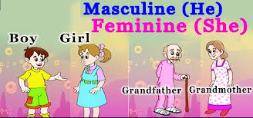
Masculine and Feminine
(Gender Words)
Grade - 06 Unit -09
Minuwangoda Zonal Education Office
E -Igenum Piyasa

Slide 2
What is masculine and feminine?
Masculine nouns are words for men, boys and male animals.
Feminine nouns are words for women, girls and female animals.

Slide 3
Masculine and feminine for people.
Masculine | Feminine
actor | actress
man | woman
father | mother
poet | poetess
gentleman | lady
prince | princess
lad | lass
boy | girl
grandfather | grandmother
god | goddess
male | female
bridegroom | bride
author | authoress
duke | duchess

Slide 4
Masculine | Feminine
land load | Land lady
host | hostess
grandson | granddaughter
waiter | waitress
manager | manageress
headmaster | headmistress
man | woman
Father- in-law | Mother-in-law
monk | nun
milkman | milkmaid
hero | heroine
hunter | huntress
monitor | monitress
mayor | mayoress
king | queen
nephew | neice

Slide 5
Masculine and feminine for animals.
Masculine | Feminine
tiger | tigress
lion | lioness
bull | cow
deer | doe
Billy goat | Nanny goat
drake | duck
cock | hen
fox | vixen
dog | bitch
lion | lioness

Slide 6
What are gender neutral words?
Gender neutral words can refer to both men and women.
Masculine | Feminine | Gender Neutral
father | mother | parent
boy | girl | child
cock | hen | chicken
waiter | waitress | servant
husband | wife | spouse
baby boy | baby girl | infant
boy friend | girl friend | friend

Slide 7
Thank You!

