Slide 1
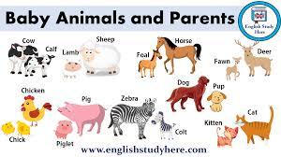
ANIMALS AND THEIR YOUNG
Grade -06 Unit -11 Activity - 08
Minuwangoda Zonal Education Office
E- Igenum Piyasa

Slide 2
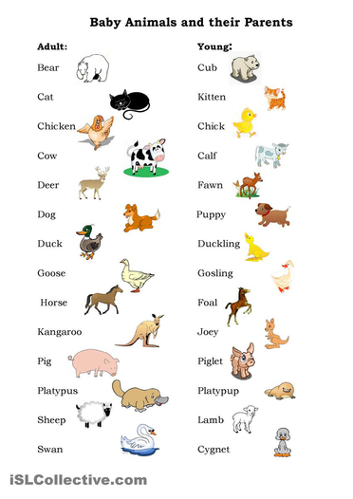

Slide 3
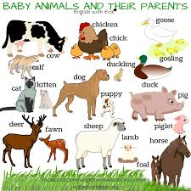

Slide 4
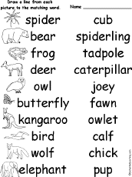

Slide 5
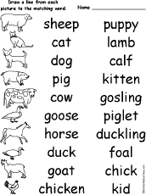

Slide 6
THANK YOU.

